Slide 1
Pattern Making
Lesson 1 – Using A Premade pattern

Slide 2
Let’s Start with the Basics
In order to use a premade pattern, or make one of your own, there’s a few things you need to understand first
These things are Seam Allowance, Measurements, and Folds

Slide 3
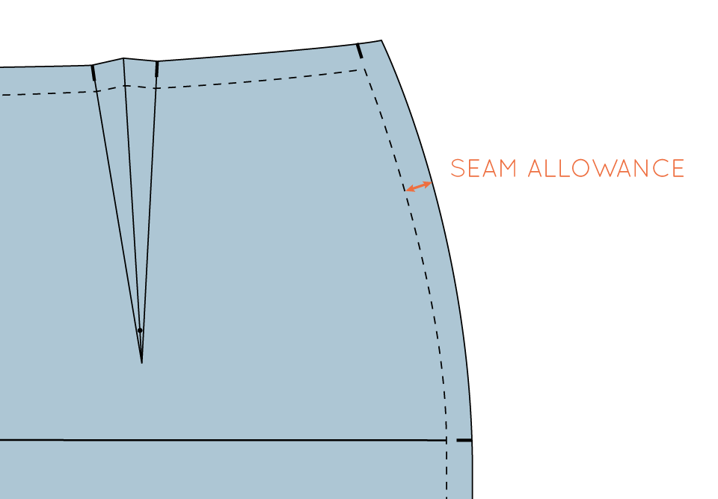
Seam Allowance
This outer edge here is what is called
Seam Allowance
Seam Allowance is as the name implies, the extra fabric needed to allow for a seam in the clothing
Seam Allowance must always be at minimum ¼ of an inch thick. However ½ is usually more standard

Slide 4
Measurements
Getting Measurements right are very important and will vary by pattern and person
Knowing how to use measurements to make a pattern will be talked about later
Common important measurements are chest, hips, shoulders, waist, and garment length

Slide 5
Measurements pt.2
A chest measurement should be taken by wrapping the tape measure all the way around your body and the largest point in the chest
Hips and Waist measurements are the same, just with Waist being the smallest point
Shoulders is obviously from the end of one shoulder to the other
Garment Length will vary from piece to piece, but is usually the waist down to where ever you was the garment to fall on your legs

Slide 6
Folds
There are two types of Folds. Well start with standard folds.
Standard Folds are when on the edge of a pattern the in a box with the world Fold in or next to it.
This means you need to fold the fabric there and not cut along that line

Slide 7
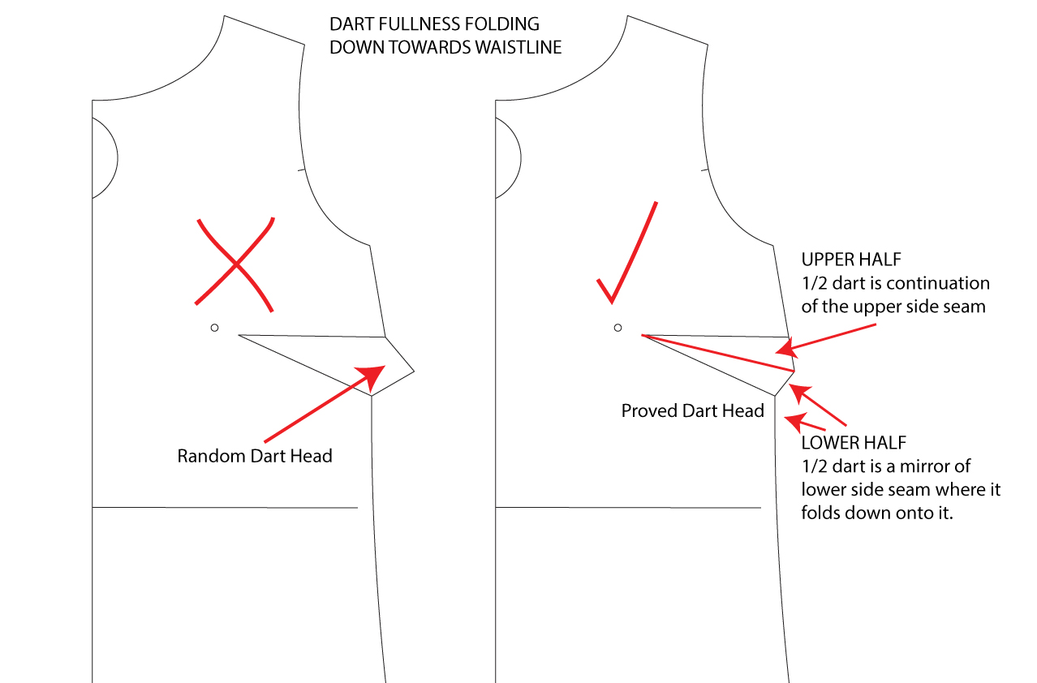
Folds pt.2
The second kind of Fold is called a Dart
Darts will end up being cut out of the fabric, or folded in so they’re not seen in the end product
Darts simply mark excess fabric

Slide 8
Video Time
https://www.youtube.com/watch?v=8kJx3SiGKtA

Slide 9
Practice – Assignment 3-1
In this assignment pick out three of the premade patterns in the classroom
Use these patterns to cut out garment pieces
See Assignment 3-1 paper for more information

